Slide 1


BASIC ELECTRONICS AND ELECTRICAL ENGINEERING
BY- CHANDANA MN (CSE-087)
HARSHITHA MASUR(AE-016)
PRIYANKA HANSDA(AE-009)
ASSIGNED BY- DR.HARINATH AIREDDY

Slide 2

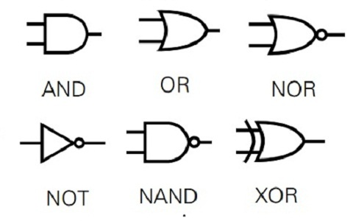
VERIFICATION OF LOGIC GATES

Slide 3

Logic gates
Logic gates are the basic building blocks of any digital system. It is an electronic circuit having one or more than one input and only one output. The relationship between the input and the output is based on a certain logic.

Slide 4
Types of logic gates
The basic logic gates are classified into seven types:
AND gate
OR gate
XOR gate
NAND gate
NOR gate
XNOR gate
NOT gate.

Slide 6
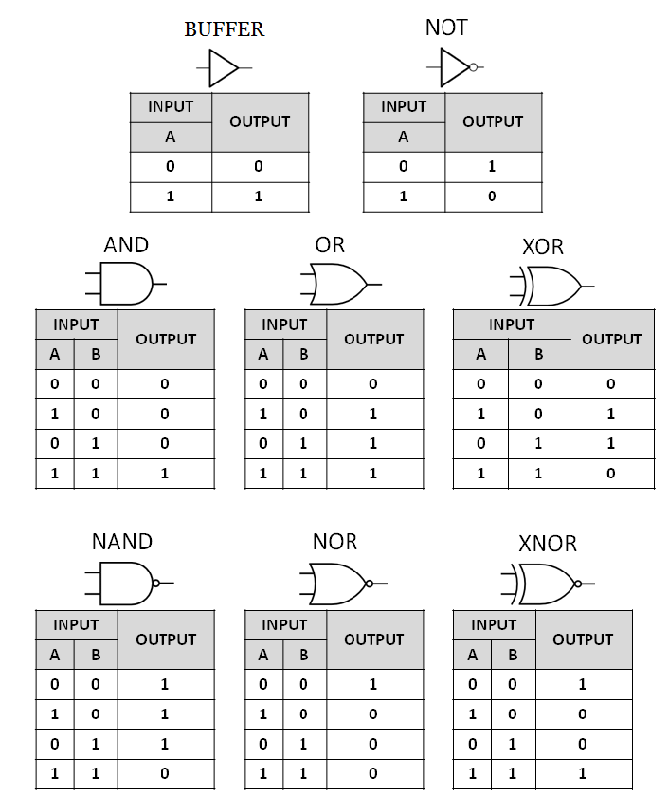

Slide 7
NOW LET US GO TO THE EXPERIMENT

Slide 8

Aim:
To study the operation of logic gates and verify their truth table.

Slide 9
Apparatus required:
Sl.no | Components | Quantity
1 | Digital trainer | 1
2 | IC 7404(NOT gate) | 1
3 | IC7408(AND gate) | 1
4 | IC7432(OR gate) | 1
5 | IC7486(Ex-OR gate) | 1
6 | IC 7402(NOR gate) | 1
7 | IC 7400(NAND gate) | 1
8 | IC 4077 (EX-NOR gate) | 1

Slide 10
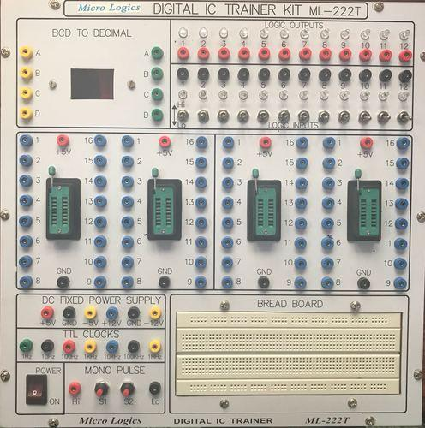

Slide 11
Theory:
Logic gates are digital circuits with one or more input signals and only one output Signal. Gates are digital circuits because the input and output signals are eitherlow or High voltages. Gates are often called logic circuits because they can be analyzed using Boolean algebra.

Slide 12
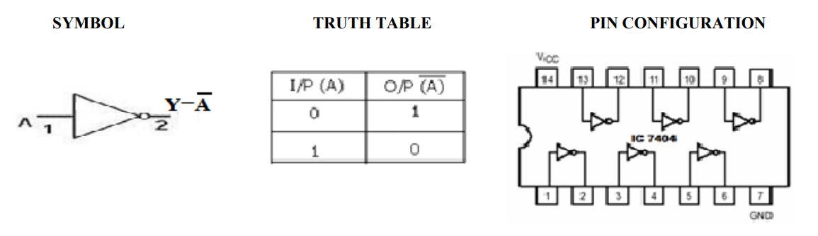
Operations:
NOT GATE: IC7404

Slide 13
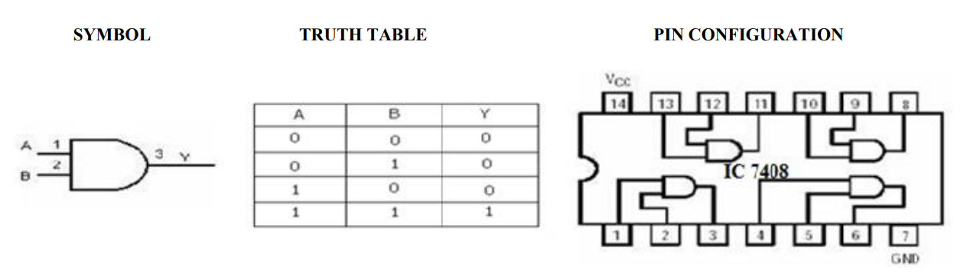
AND GATE: IC7408

Slide 14
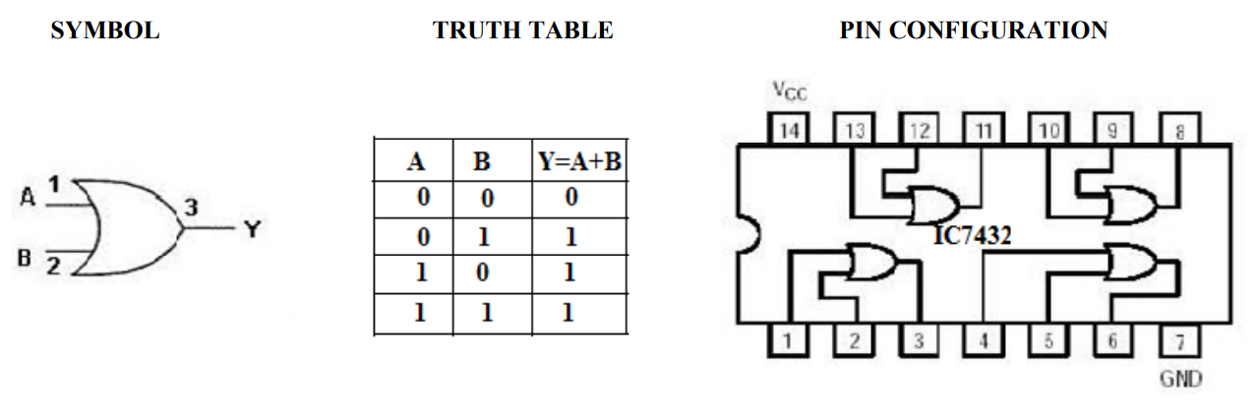
OR GATE: IC7432

Slide 15
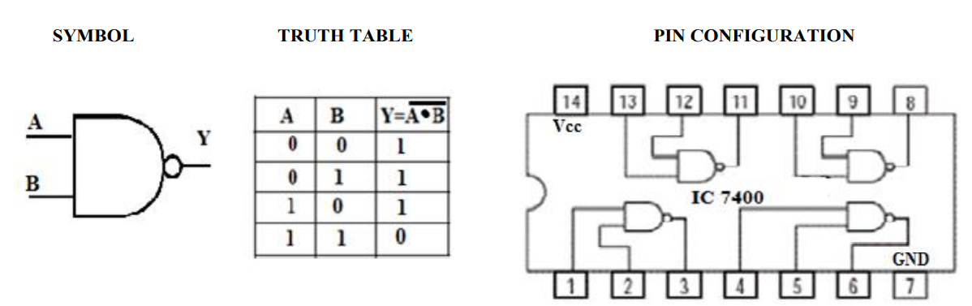
NAND GATE: IC7400

Slide 16
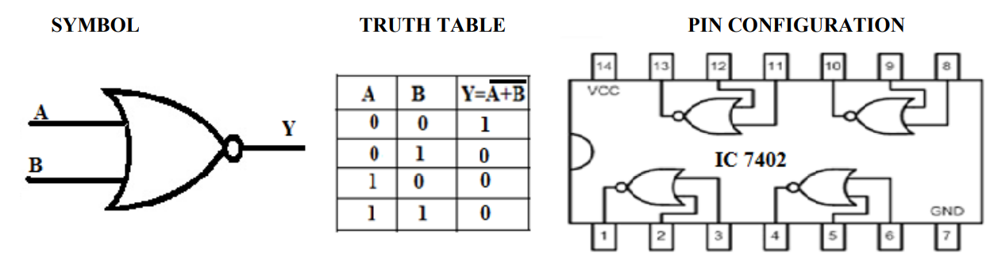
NOR GATE: IC7402

Slide 17
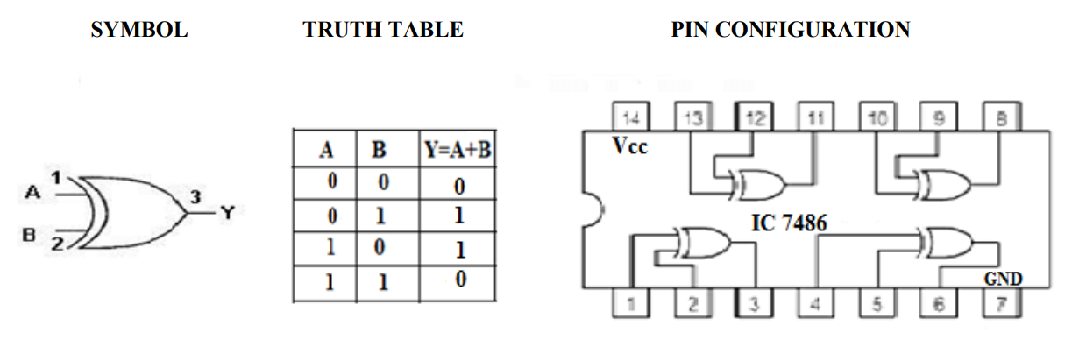
EX-OR GATE: IC7486

Slide 18
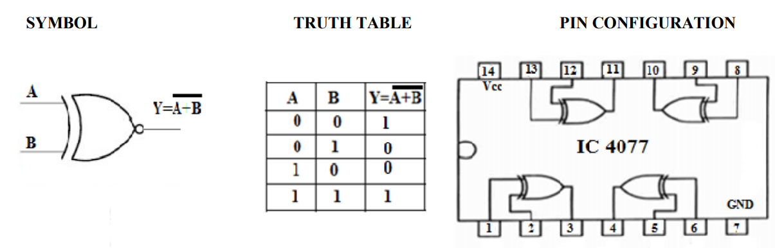
EX-NOR GATE: IC4077

Slide 19
Result:
The truth table of the all logic gates are verified

Slide 20
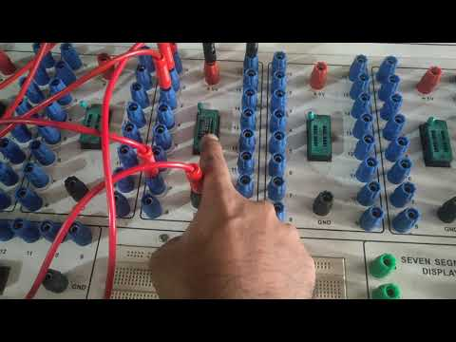

Slide 21
APPLICATION
BELL
COMPUTERS
SWITCH
BURGLAR ALARAM
DETECTORS
AIR CRAFT LOGIC CIRCUIT.

Slide 22


